Slide 1
XYZ Ads Airing Report Analysis

Slide 2
Project description
In the given project we were provided with advertisement data of 6 automobile brands:- Tata, Mahindra, Maruti Suzuki, Toyota, Honda and Hyundai
We are asked to find relationship between pod position and spending, Quarterly Change of share of ads in TV airing.
We were asked to determine the advertisement strategy of various brands and how they differ across the brands
Finally, we were asked to suggest a digital ad campaign for Mahindra & Mahindra which mimics their TV advertisement strategy

Slide 3
approach
Data cleaning* and understanding the data set
Understanding the required insight
Making pivot tables and/or using formulas and functions to find the required insight
Making Charts for better Visualisation
* There was no need for data cleaning in the given dataset

Slide 4
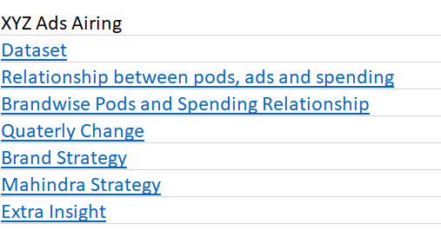
Tech stack used
I used Excel for the given project
It is a fairly powerful tool and can analyse the dataset of this size and pivot table and its formulas & functions assist in deep analysis
The charts provided excel helps in efficient data visualisation
This is the link to the Excel File
Many Tables and Visualisation can be seen in the excel sheets , this is the table of contents of the excel sheet

Slide 5
Insights

Slide 6
Pod position and spending relationship
An ad pod is a group of ads that are sequenced together to be played back-to-back within a single ad break/placement, similar to ad breaks in traditional linear TV. Ad pods give publishers the opportunity to maximise revenue from each ad break and give advertisers more control over ad positioning.
According to TVision data, ads that play first during the commercial break do, in fact, consistently command higher attention than those that air later in the same pod. This is especially true for linear TV, where first-in-pod placements average 5 percentage points higher for viewers who keep their eyes on the screen for two or more seconds.

Slide 7
Pod position and spending relationship
Correlation between pod number and total amount spend can be seen to be -0.76 which shows that as pod number increases the spending decreases
Correlation
 | Pod Number | Number of Ads or IDs | Total Amount Spend ($)
Pod Number | 1
Number of Ads or IDs | -0.774607447 | 1
Total Amount Spend ($) | -0.761502735 | 0.996200643 | 1
The given graph shows that there is a overall decrease in the spending amount as the pod number increase
*The table can be seen in sheet 3 pods ads amount of the attached excel sheet

Slide 8
Quarterly Change of Ad Share
During Quarter 1-> Maruti had the largest share followed by Mahindra
And Toyota had the lowest share. Honda, Hyundai and Tata Being 3rd , 4th and 5th respectively
During Quarter 2 -> Tata dropped to the lowest and top 2 held their spot and Toyota took the 3rd spot from the last spot in Quarter-1, position held by Honda
During Quarter 3 -> While top 2 retained their spot Honda regained its 3rd position pushing Toyota to 4th
In the last quarter while Maruti remained the top spot, Mahindra and Mahindra dropped to 3rd and Tata took its place and Toyota fell to the last position just like in the first quarter with Hinda and Hyundai being 4th and 5th respectively
*can be seen in Excel Sheet Quarterly Change
Count of Id | Brand
Quarter | Honda Cars | Hyundai Motors India | Mahindra and Mahindra | Maruti Suzuki | Tata Motors | Toyota
Quarter 1 | 12.44% | 10.48% | 19.71% | 38.78% | 10.12% | 8.46%
Quarter 2 | 9.77% | 9.84% | 24.01% | 37.31% | 7.62% | 11.45%
Quarter 3 | 12.99% | 9.17% | 22.05% | 36.55% | 8.03% | 11.21%
Quarter 4 | 11.29% | 9.23% | 13.57% | 41.10% | 20.93% | 3.87%
Grand Total | 11.65% | 9.74% | 20.21% | 38.30% | 11.07% | 9.02%

Slide 9
Quarterly Change of Ad Share
*seen in Quarterly Change Excel Sheet
While only Maruti and Tata increase their add share from Quarter 1 to Quarter 4
Hyundai, Honda, Mahindra and Toyota lost their market share
Tata saw maximum gain of 10%, M&M saw the max loss of 6%
Maruti had the largest market share across all quarters
Notes:
M&

Slide 10
Brand strategy
BRAND NAME | MAX COUNT OF ID | MAX COUNT OF ID DAYPART | MAX AVERAGE SPEND | MAX AVERAGE SPEND DAYPART | MAX SUM OF SPEND | MAX SUM OF SPEND DAYPART | % OF TOTAL AD BUDGET | Max targeted hour | Percentage Share | Max targeted hour2 | Percentage Share2 | Max targeted hour3 | Percentage Share3
Honda Cars | 28031 | DAYTIME | $835 | PRIME TIME | $1,51,06,799 | DAYTIME | 31.30% | 15 | 8.05% | 16 | 7.74% | 17 | 6.79%
Hyundai Motors India | 13508 | PRIME TIME | $6,421 | PRIME TIME | $8,67,37,738 | PRIME TIME | 47.97% | 21 | 16.48% | 20 | 14.63% | 22 | 12.24%
Mahindra and Mahindra | 33552 | DAYTIME | $5,396 | PRIME TIME | $15,27,13,257 | PRIME TIME | 38.44% | 21 | 13.44% | 20 | 13.40% | 22 | 10.42%
Maruti Suzuki | 49811 | DAYTIME | $4,475 | PRIME TIME | $21,36,09,797 | PRIME TIME | 38.24% | 21 | 13.35% | 20 | 12.99% | 22 | 10.41%
Tata Motors | 17745 | DAYTIME | $1,939 | EVENING NEWS | $2,56,52,452 | PRIME TIME | 27.06% | 21 | 10.11% | 20 | 8.81% | 19 | 8.41%
Toyota | 17393 | DAYTIME | $3,816 | PRIME ACCESS | $2,69,37,315 | WEEKEND | 23.91% | 19 | 10.36% | 17 | 8.05% | 18 | 7.89%
Excel sheet brand strategy
Rank of Count of ID | Duration
Row Labels | 5 | 10 | 15 | 20 | 30 | 45 | 60 | 75 | 120
Honda Cars |  | 3 | 2 |  | 1
Hyundai Motors India |  |  | 2 |  | 1 |  |  | 3
Mahindra and Mahindra | 4 | 6 | 3 | 2 | 1 | 7 | 5
Maruti Suzuki | 2 | 4 | 3 | 5 | 1 |  | 6
Tata Motors | 3 | 4 | 1 |  | 2 |  | 5
Toyota |  | 5 | 2 |  | 1 |  | 4 | 6 | 3

Slide 11
Brand Strategy
Max market share by Maruti then M&M followed by Honda, Tata, Hyundai, Toyota
Max Average Spending by Mahindra then Hyundai, followed by Maruti, Toyota, Tata and Honda
Max Amount Spend by Maruti, then M&M followed by Hyundai, Toyota, Tata, Honda
Excel sheet brand strategy

Slide 12
Brand strategy
Excel sheet brand strategy

Slide 13
Brand Strategy
Excel sheet brand strategy

Slide 14
Brand strategy
Honda Cars
They have maximum adds and max spending for daytime adds
They have max average spending for Prime Time adds
Honda targets 15th followed by 16th and 17th hour
Maximum adds are of 30 minute duration followed by 15 then 10
Hyundai Motors India
They have maximum adds and max spending for Prime Time adds
They have max average spending for Prime Time adds
Hyundai targets 21st followed by 20th and 22nd hour
Maximum adds are of 30 minute duration followed by 5 then 15

Slide 15
Brand strategy
Mahindra and Mahindra
They have maximum adds in daytime
They have max average spending and maximum spending for Prime Time adds
M&M targets 21st followed by 20th and 22nd hour
Maximum adds are of 30 minute duration followed by 20 then 15
Maruti Suzuki
They have maximum adds in daytime
They have max average spending and maximum spending for Prime Time adds
MS targets 21st followed by 20th and 22nd hour
Maximum adds are of 30 minute duration followed by 15 then 75

Slide 16
Brand strategy
Tata Motors
They have maximum adds in daytime and maximum spending for Prime Time ads
They have max average spending for evening news
M&M targets 21st followed by 20th and 19th hour
Maximum adds are of 15 minute duration followed by 30 then 5
Toyota
They have maximum adds in daytime and maximum spending for Weekend ads
They have max average spending for Prime Access
Toyota targets 19th followed by 17th and 18th hour
Maximum adds are of 30 minute duration followed by 15 then 120

Slide 17
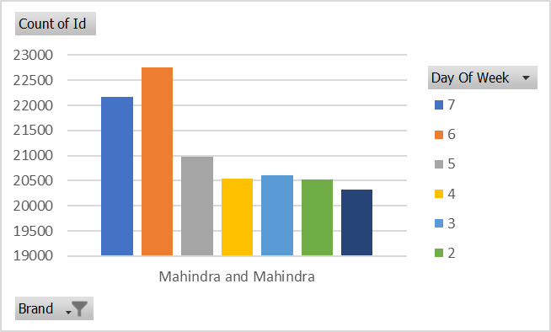
MAHINDRA AND MAHINDRA DIGITAL AD Campaign
Hour of the Day | Count of Id
Mahindra and Mahindra | 147890
21 | 9326
22 | 9065
20 | 9029
1 | 8240
0 | 8152
23 | 8057
9 | 8033
10 | 7705
16 | 7178
17 | 7059
13 | 7027
18 | 6961
12 | 6960
11 | 6898
14 | 6181
19 | 5820
15 | 5722
8 | 4543
7 | 4385
6 | 4150
3 | 2762
2 | 2742
4 | 974
5 | 921
Day Part | Count of Id
Mahindra and Mahindra | 147890
DAYTIME | 33552
PRIME TIME | 28302
LATE FRINGE | 24468
WEEKEND | 23167
EARLY MORNING | 13999
EARLY FRINGE | 9335
OVERNIGHT | 6480
EVENING NEWS | 4549
PRIME ACCESS | 4038
Count of Id | Timezone
Row Labels | Central India | Northeast India | Northern India | Southern India
Mahindra and Mahindra | 205 | 144949 | 35 | 2701
Grand Total | 205 | 144949 | 35 | 2701
Excel Sheet Mahindra

Slide 18
MAHINDRA AND MAHINDRA DIGITAL AD Campaign
Based on Previous Graphs and Tables M&M’s Digital AD Campaign should be like this
Maximum targeting of North East Time Zone
Maximum ads on Saturday followed by Sunday
Inverse relationship between Pod Position and Number of Ads
Maximum number ads during Day Time followed by Prime Time and Late Fringe
Maximum number of ads during 21st hour followed by 22nd then 20th hour
Maximum spending in month of May followed by August then Jan, least in December and November

Slide 19
EXTRA INSIGHT
Honda City had no ads in Q2,3,4 XUV 700 had no ads in Q4. Maruti Suzuki Celerio had no ads in Q1,4 Ignis had no ads in Q1,3,4. Toyota Fortuner had no ads in Q1,2,3
While Honda has low total spending and low average spending when compared to other brands it still has the 3rd highest Market Share
Max spending is for Prime Time daypart and Pod position 1
Extra Insight excel Sheet

Slide 20
RESULT
The project helped in understanding how to analyse advertisement data and make effective insights
Further strengthening of understanding of Charts in excel. Extensively used XLOOKUP function for data extraction and insight helped in the deeper understanding of the function

